Slide 1

Mission week in Computing j
HOPE
Creating animations to tell people how we can
Care for Creation

Slide 2
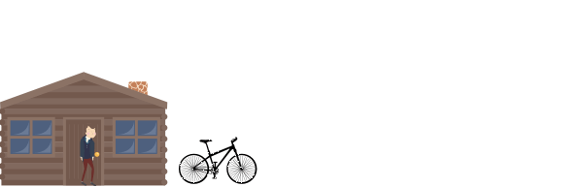


Slide 3
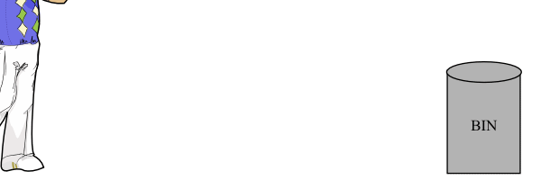


Slide 4

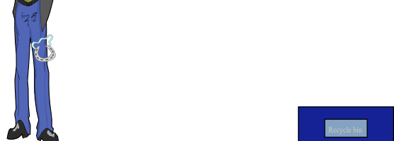

Slide 5



Slide 6
Hope and Kind
It really doesn’t take that much
To feel the warmth
Of someone’s touch
To share a moment
Without disdain
And give a little happiness
Help relieve the pain
Console those who
Have no choice
When eyes say everything
And sadness steals their voice
To care for a stranger
You will find
That hope is uplifted
By the loving kind
A hub of faith
Contributed by Mr Ray Storer

