Slide 1

BGN Whole School Mission Week
January 2025
A hub of faith and learning with Christ at its centre
A hub of faith and learning with Christ at its centre

Slide 2
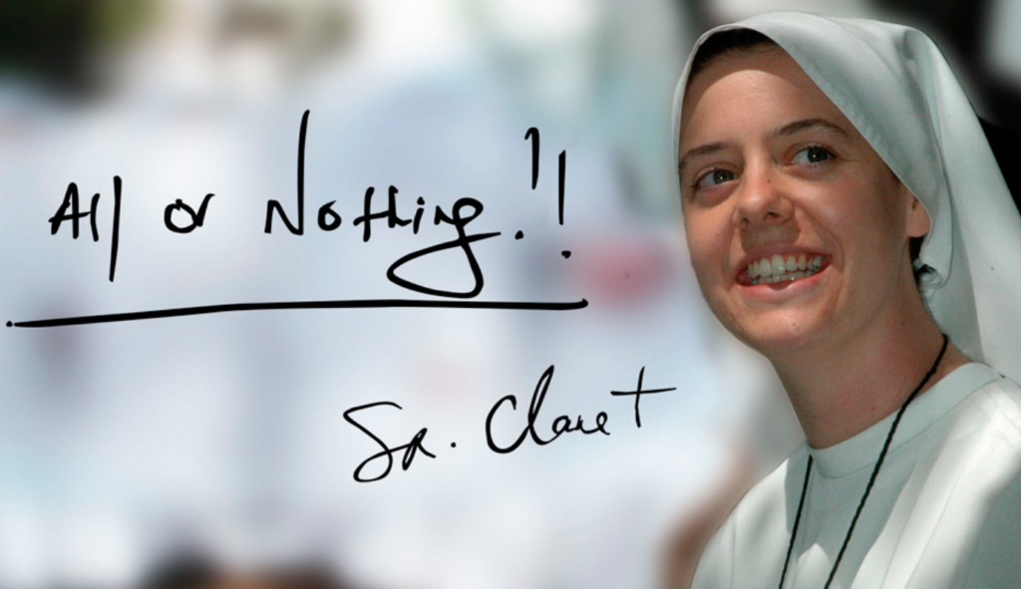
For our BGN Whole School Mission week in R.E we have been focusing on the theme of hope by looking into the life of Sister Clare Crockett
Sister Clare Crockett from the City of Derry died whilst serving as a nun in Ecuador in 2016.
She was declared a Servant of God by the Catholic Church - the first step towards becoming a saint and a ceremony which recognised her as a candidate for sainthood, was held in Madrid earlier this month.
We have studied the life of Sister Clare, her impact on the world whilst alive and how her ambition to be a ‘famous nun’ is now realised. She had an enormous sense of FUN!
Sister Clare’s friends were said to be in disbelief after she announced her decision while holding a "beer in one hand and a cigarette in the other".
Her motto for life was, ‘All or Nothing!’
A hub of faith and learning with Christ at its centre
Students have been overwhelmed by the fact that she stated that she would die young, maybe at the same age as Jesus. Five days later, this became true when she died at the age of 33.
A hub of faith and learning with Christ at its centre

Slide 3
For our BGN Whole School Mission week in English we have been focusing on the theme of hope
What do we hope for? Something materialistic, altruistic or something even bigger – such as world peace or a solution to the global climate crisis?
We watched an amazing short video from David Attenborough, in which he gave a really important message about Hope for the world. ‘We know the problems, we know some of the solutions.’ If we all do our bit, then the damage to the world can be reversed in eighty years!
Although this time may seem beyond us, we have to remember we inherit the earth, we are its custodians and we have a duty to pass it on to the next generation, having looked after it as best we can.
A hub of faith and learning with Christ at its centre
KS3 have had a choice of tasks relating to HOPE.
They could either write a poem or create a peace of art work and write about how it symbolises hope.
KS4 Students have written a speech about the importance of having Hope.
Sometimes the world seems a difficult place, but we need to have hope.
A hub of faith and learning with Christ at its centre

Slide 4
A hub of faith and learning with Christ at its centre
A hub of faith and learning with Christ at its centre

