Slide 1

BGN Whole School Mission Week
January 2025
A hub of faith and learning with Christ at its centre
Polish A level
Year 13
A hub of faith and learning with Christ at its centre

Slide 2
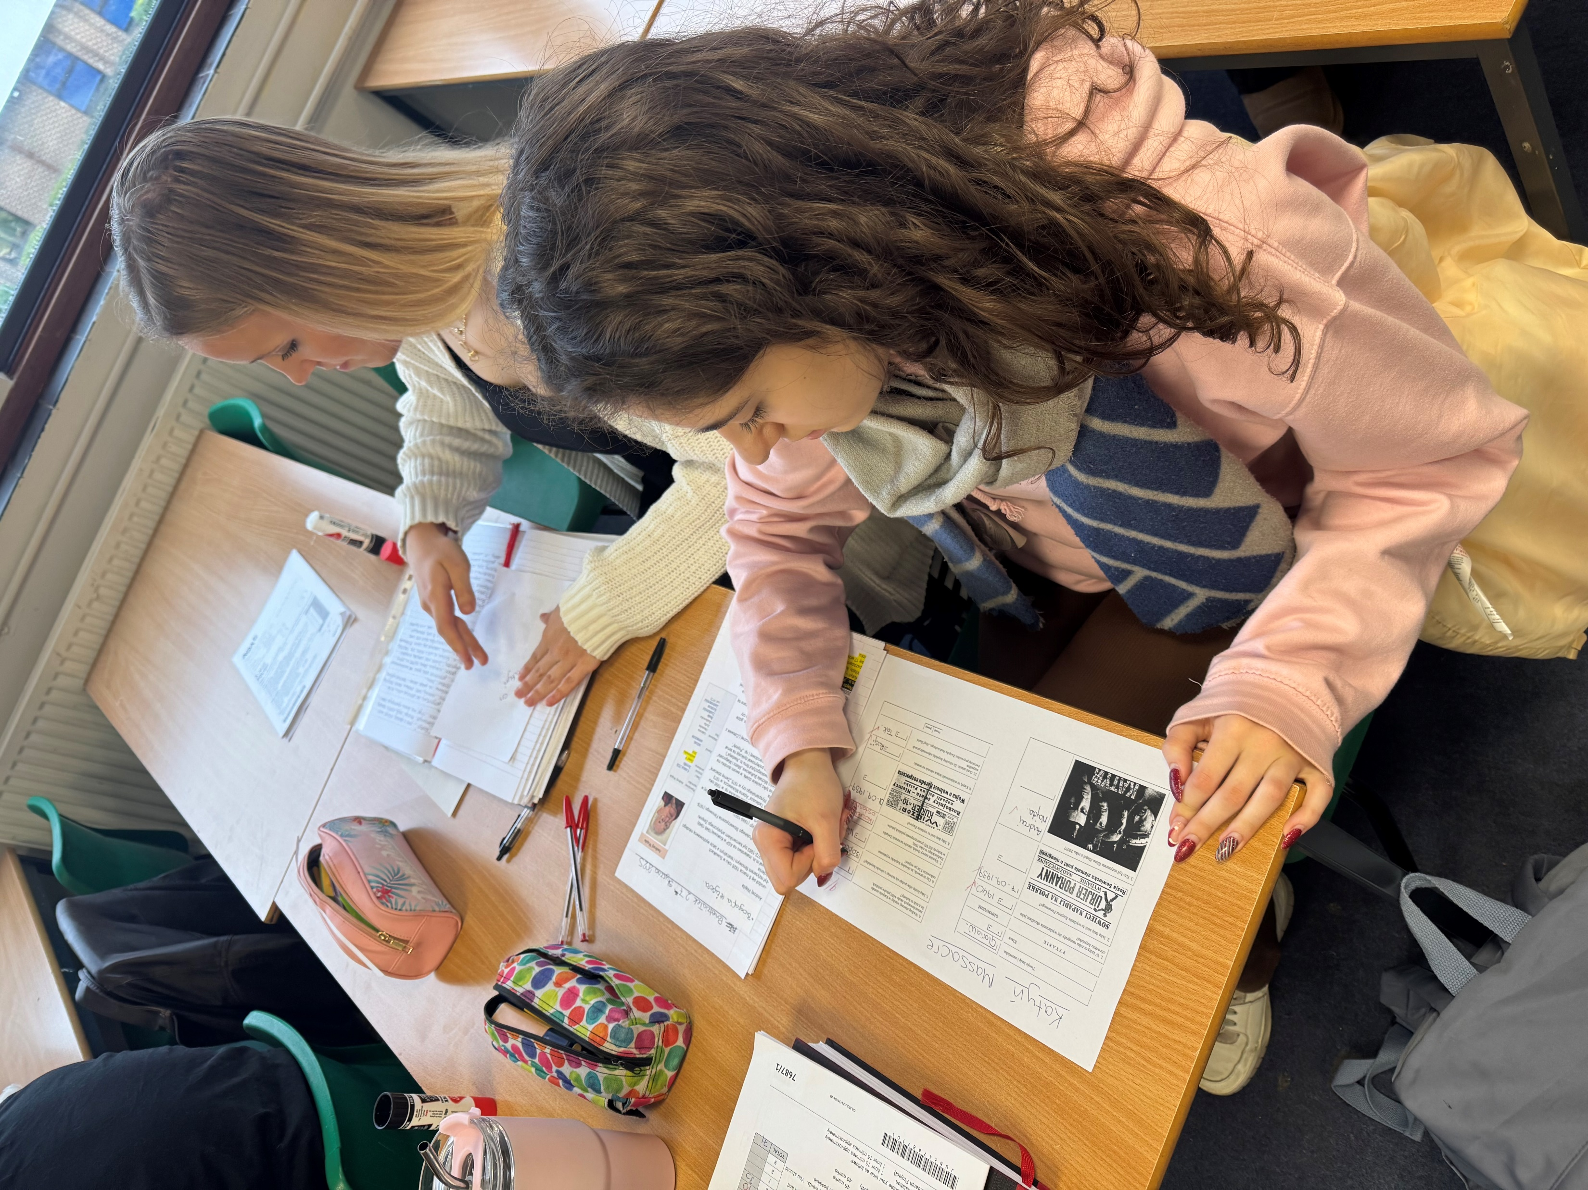
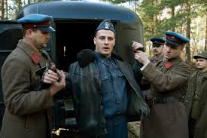
For our BGN Whole School Mission week in Year 13 we have been focusing on the theme of hope by looking into the life of families of victims of Katyn Massacre.
Information in what you have been doing for Mission week in your subject area / year group….
We discussed Katyn Massacre which was a mass execution of Polish military officers by the Soviet Union during World War II. 20 000 officers and soldiers were killed in Katyn forest in 1940, they were killed with a shot to the back of the head. Year 13 students watched the film and we looked not only at historical background but also at hope of women waiting for their loved ones to come back from the Soviet captivity. Despite the lists of murdered officers, women had hope that their husbands, sons, fathers, nephews will come back as Hope dies last.
A hub of faith and learning with Christ at its centre
The final scene shows that the officers
who were about to be shot
had hope in God
as they were saying „Our father”-Gloria
Students have commented……
Anna,main protagonist, belived that
her husband is alive,
she had hope till the very last day!-Kamila
The pilot had hope in God, he was
holding the Rosary Beads at the moment of death-Patryk
A hub of faith and learning with Christ at its centre

