Slide 1

BGN Whole School Mission Week
January 2025
A hub of faith and learning with Christ at its centre
A hub of faith and learning with Christ at its centre

Slide 2
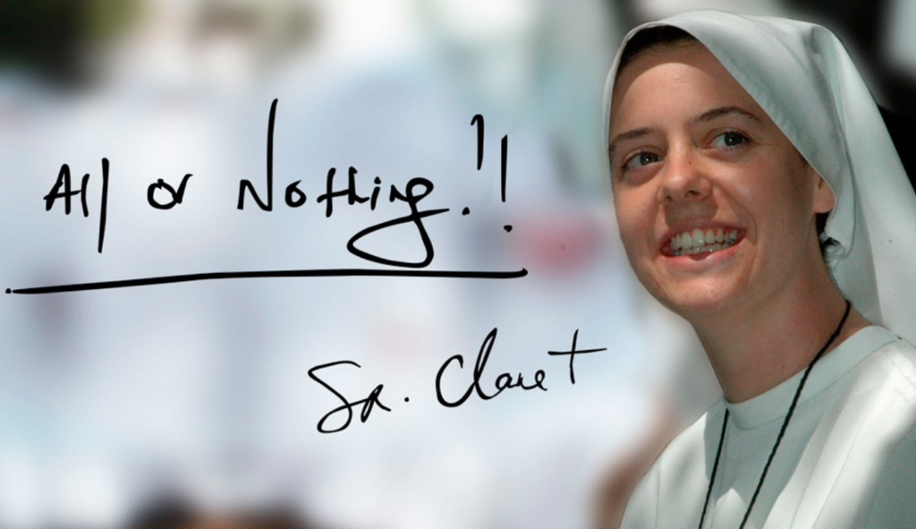
For our BGN Whole School Mission week in R.E we have been focusing on the theme of hope by looking into the life of Sister Clare Crockett
Sister Clare Crockett from the City of Derry died whilst serving as a nun in Ecuador in 2016.
She was declared a Servant of God by the Catholic Church - the first step towards becoming a saint and a ceremony which recognised her as a candidate for sainthood, was held in Madrid earlier this month.
We have studied the life of Sister Clare, her impact on the world whilst alive and how her ambition to be a ‘famous nun’ is now realised. She had an enormous sense of FUN!
Sister Clare’s friends were said to be in disbelief after she announced her decision while holding a "beer in one hand and a cigarette in the other".
Her motto for life was, ‘All or Nothing!’
A hub of faith and learning with Christ at its centre
Students have been overwhelmed by the fact that she stated that she would die young, maybe at the same age as Jesus. Five days later, this became true when she died at the age of 33.
A hub of faith and learning with Christ at its centre

Slide 3

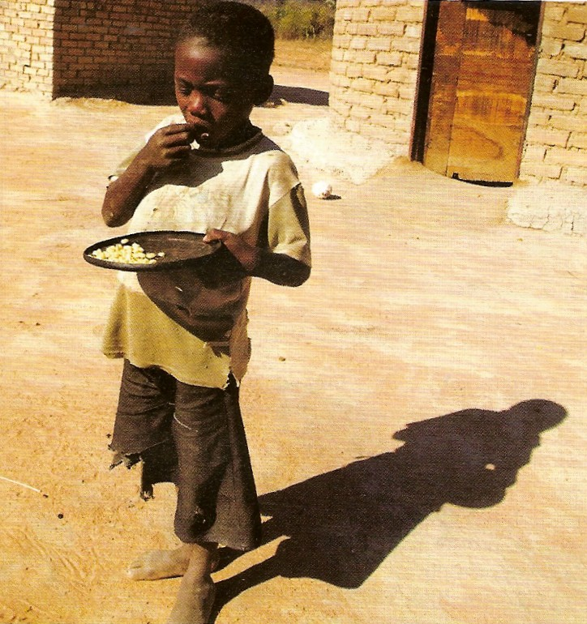
For our BGN Whole School Mission week in Geography we have been focusing on the theme of hope by looking at the global food crisis.
Using the global food crisis as a basis of hope, students:
Mapped the 12 most undernourished countries.
Identified reasons for the global food crisis, making links to population growth, oil prices, climate change, urbanisation, declining agricultural productivity and changes in income.
Finally, students looked at an example of a food bank in Cornwall and how it was giving hope to one of the most deprived areas in the UK.
A hub of faith and learning with Christ at its centre
Students have commented…… “it was surprising how many people around the world, and in the UK, don’t have enough food”.
A hub of faith and learning with Christ at its centre

Slide 4
A hub of faith and learning with Christ at its centre
A hub of faith and learning with Christ at its centre

