Slide 1

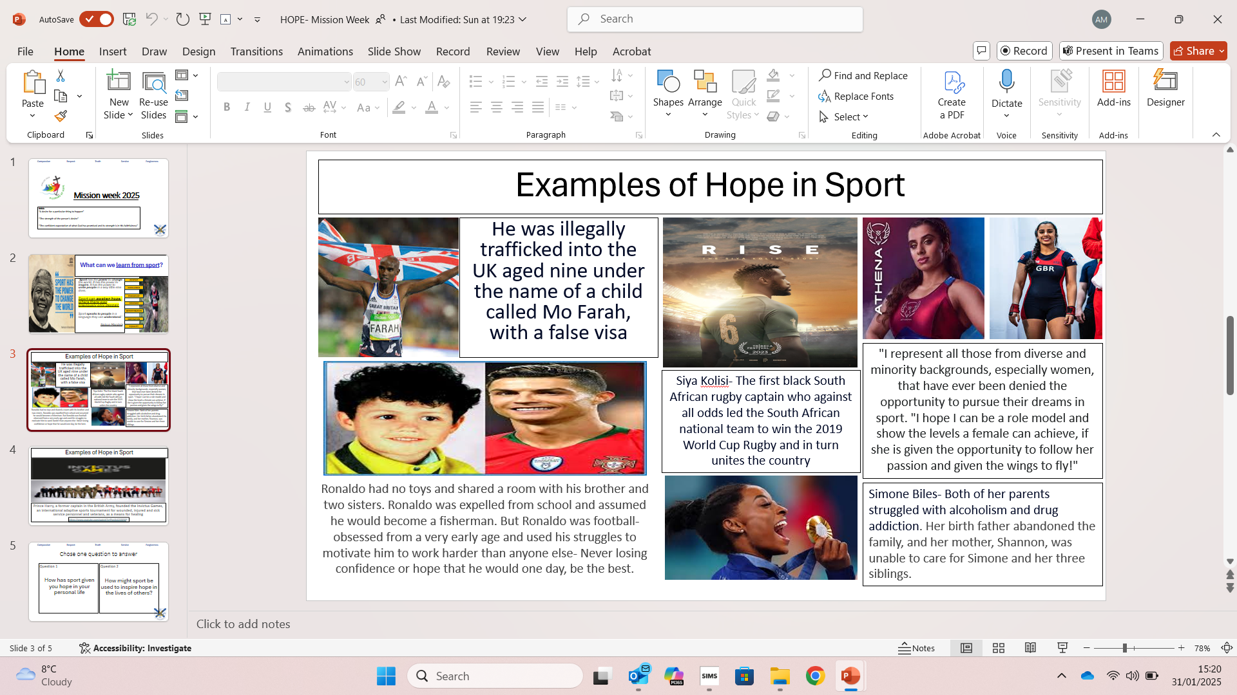
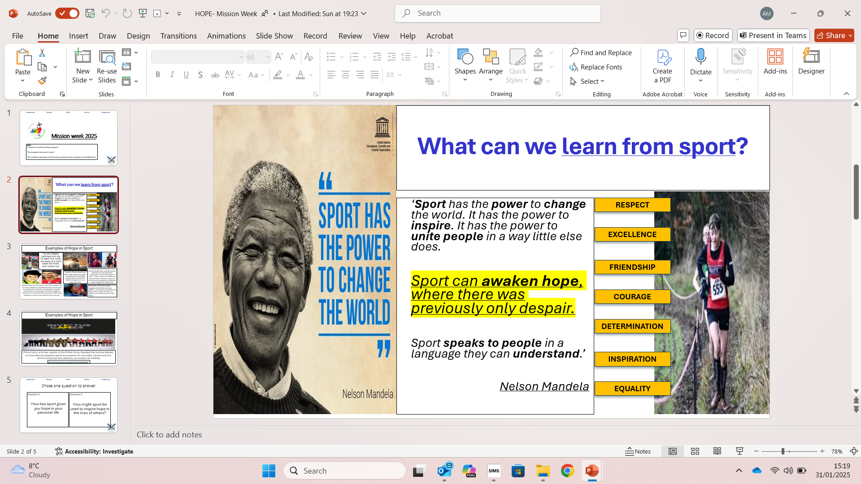
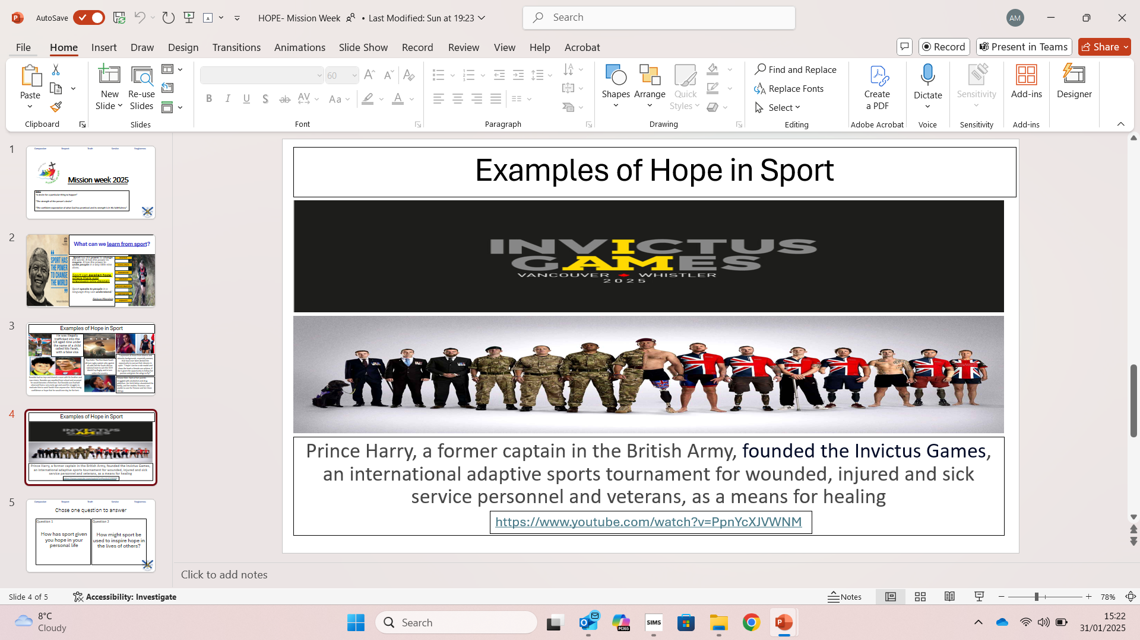
For our BGN Whole School Mission week in PE we have been focusing on the theme of hope by looking into the lives of people who have used SPORT to inspire hope in their lives. We encouraged students to tune in to the Invictus games that begins in Feb to take hope and inspiration from service personnel injured in the line of duty.
We asked students to give examples of when sport has given them hope. Student’s answers varied from; helping them to be more confident and sociable, giving them a distraction from stress, motivating them to be better and feeling proud of sporting achievements.
A hub of faith and learning with Christ at its centre
PICTURE
A hub of faith and learning with Christ at its centre

