Slide 1

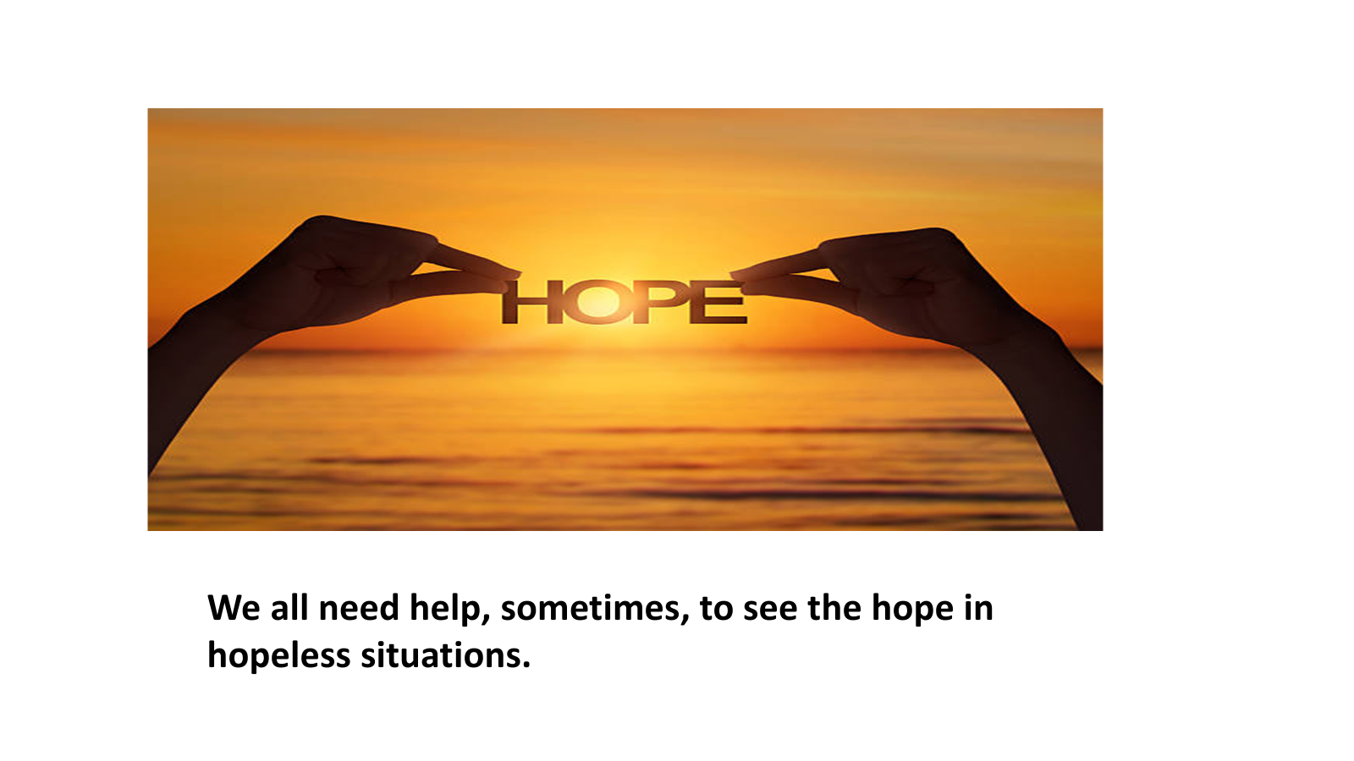
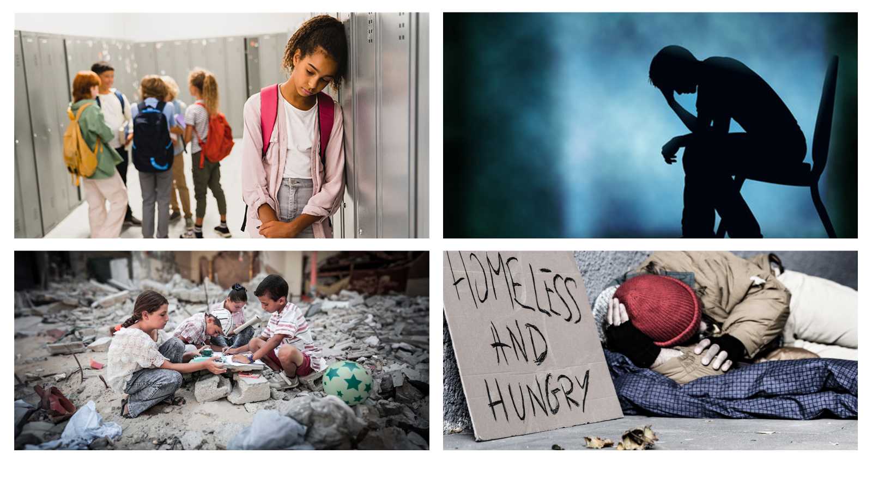
For our BGN Whole School Mission week in Drama we have been focusing on the theme of hope by looking at how we can make a difference when things seem hopeless
Year 7 students created News Reports inspired by images of War, Homelessness, Bullying and Mental Health. They used their imaginations and techniques like Freezeframes, Narration and Reportage to play characters in their News Report. Each report finished with a message for the audience about how they can make a difference and gave advise about what you can do to bring hope.
A hub of faith and learning with Christ at its centre
Students said it helped them feel empathy to play characters that might be experiencing things they didn’t understand fully themselves and itu made them think about what they could do to bring hope to people.
A hub of faith and learning with Christ at its centre

