Slide 1

BGN Whole School Mission Week
January 2025
A hub of faith and learning with Christ at its centre
A hub of faith and learning with Christ at its centre

Slide 2
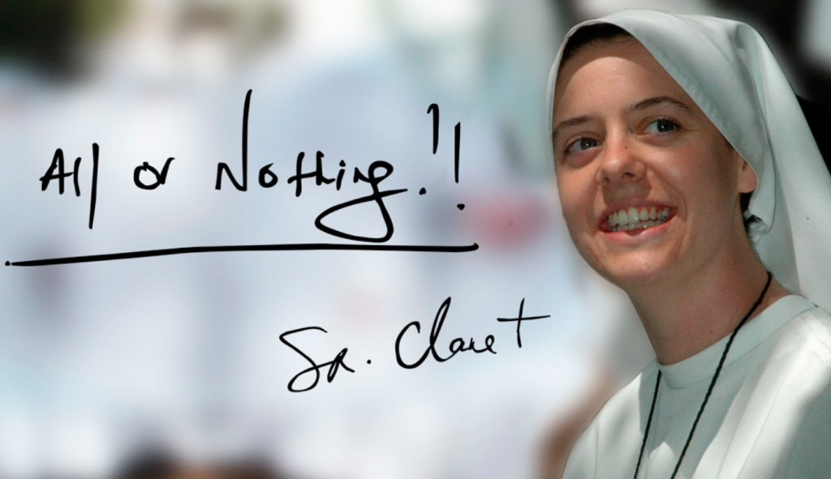
For our BGN Whole School Mission week in R.E we have been focusing on the theme of hope by looking into the life of Sister Clare Crockett
Sister Clare Crockett from the City of Derry died whilst serving as a nun in Ecuador in 2016.
She was declared a Servant of God by the Catholic Church - the first step towards becoming a saint and a ceremony which recognised her as a candidate for sainthood, was held in Madrid earlier this month.
We have studied the life of Sister Clare, her impact on the world whilst alive and how her ambition to be a ‘famous nun’ is now realised. She had an enormous sense of FUN!
Sister Clare’s friends were said to be in disbelief after she announced her decision while holding a "beer in one hand and a cigarette in the other".
Her motto for life was, ‘All or Nothing!’
A hub of faith and learning with Christ at its centre
Students have been overwhelmed by the fact that she stated that she would die young, maybe at the same age as Jesus. Five days later, this became true when she died at the age of 33.
A hub of faith and learning with Christ at its centre

Slide 3

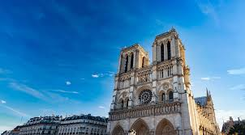
For our BGN Whole School Mission week in French we have been focusing on the theme of hope by looking into the reopening of Notre Dame de Paris
We watched a news video about the reopening of Notre Dame after the devastating fire in 2019. We saw the sense of loss experienced at the time, we learned about the amazing and tireless work that went into the restoration, and we saw the beautiful end result as Notre Dame reopened to the public in December 2024.
We listened to a French version of Hallelujah by Vianney, written especially for the reopening.
Pupils in Year 10-13 also translated a particularly moving text about the reopening, ending “Hope is nourished by prayer. Hope is nourished by our daily choices”.
A hub of faith and learning with Christ at its centre
Students have commented on how beautifully the building has been restored, and found the hymn and the prayer about hope to be particularly moving.
A hub of faith and learning with Christ at its centre

Slide 4

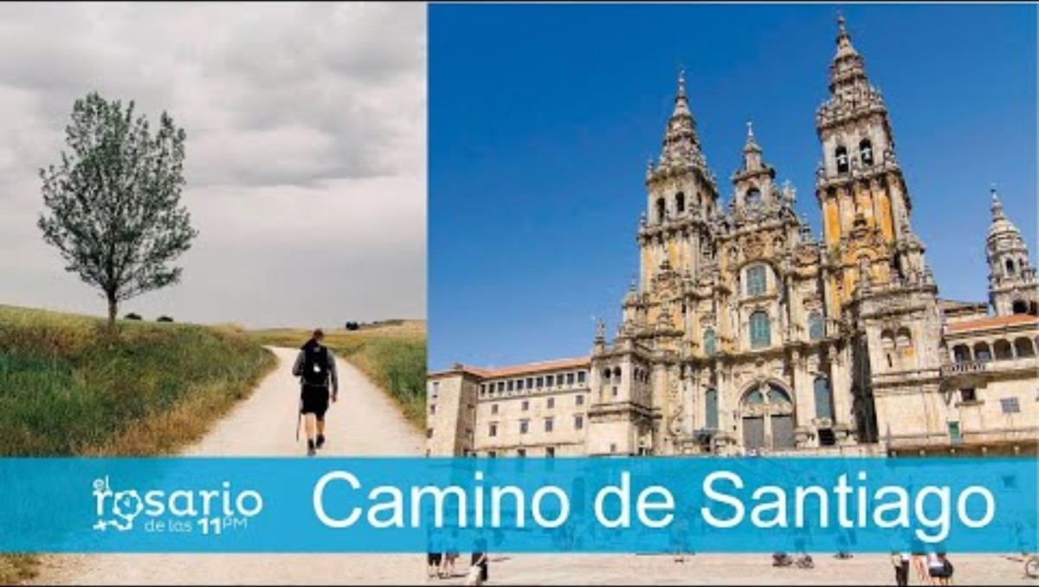
For our BGN Whole School Mission week in Spanish we have been focusing on the theme of hope by looking into el Camino de Santiago (the Way of St James)
In Spanish we learned about the Camino de Santiago. As part of this we learnt about St James travelling to Spain and his remains later being buried here. We discovered the early days of pilgrimage and what this journey means for pilgrims today.
We also learned lots of new Spanish words connected with the Camino de Santiago.
A hub of faith and learning with Christ at its centre
Students were particularly surprised at what a long way pilgrims walk as part of the Camino!
A hub of faith and learning with Christ at its centre

Slide 5
A hub of faith and learning with Christ at its centre
A hub of faith and learning with Christ at its centre

