Slide 1
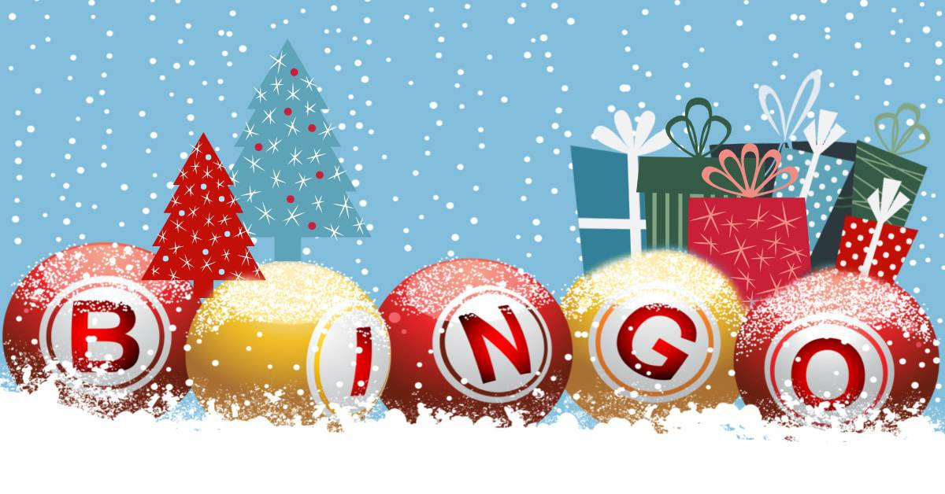

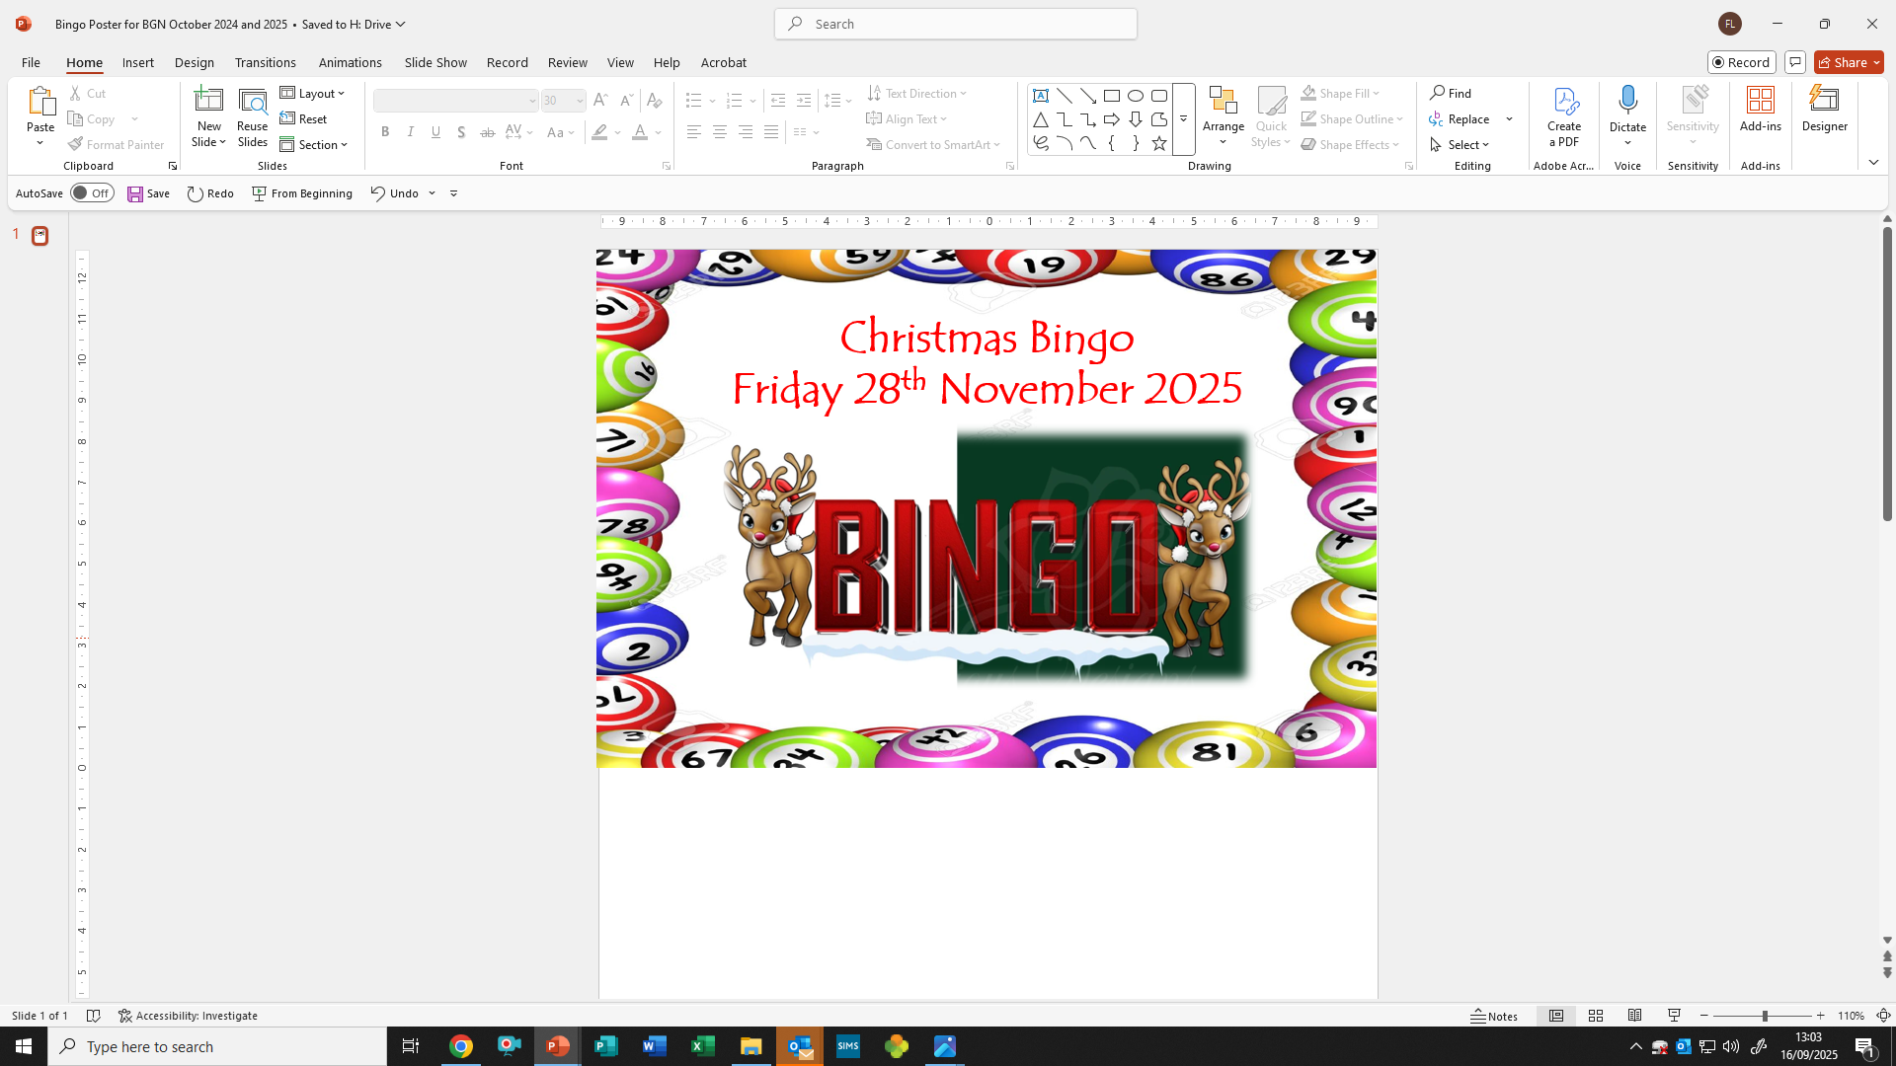
Christmas Family Bingo Night
Friday 27th November 2026
6.30 pm – 8.30 pm
Tickets will be available to buy on the door
£1.50 for a single book.
Drinks and snacks will be available to purchase on the night.
Do come and join us for a family fun packed evening.
We look forward to seeing you all.

