Slide 1



Apprenticeships

Slide 2


WHAT WE WILL COVER TODAY:
What is an Apprenticeship
How to choose one/Apply
CV
© Copyright 2021. All rights reserved - Adviza Partnership

Slide 3

What is an
APPRENTICESHIP
What?
What next?
Where?
Vocational Qualification
80% work/20% study
You study one subject
Cannot mix with other quals
Paid a Salary
Minimum 1 year/ 30 hours
per week
Workplace
Learning Provider: could be college/uni, in-house training, external assessors etc
University
Gap Year
Higher or Degree Apprenticeship
Workplace
© Copyright 2021. All rights reserved - Adviza Partnership

Slide 4

Intermediate (Level 2)
Entry: 3-4 GCSEs 3+
Option to retake Maths/English
Examples: Optical Assistant, Chef, Hairdressing, Accounts
Advanced (Level 3)
Entry: 5+ GCSEs 4+
Examples: Dental Nurse, Business Admin, Nursery, Marketing, IT
APPRENTICESHIP
LEVELS
Higher (Levels 4 & 5)
Entry: at least 2 A Levels or equivalent
Examples: Accounting, IT
Degree (Levels 6 & 7):
Entry: at least 3 A Levels or equivalent
Examples: Law, Engineering, Nursing
© Copyright 2021. All rights reserved - Adviza Partnership

Slide 5




Apprenticeship vacancies
There isn’t one deadline
Focus on opening dates – be ready from now
Apprenticeships are advertised in different places
Sign up to lots of sites and manage your alerts
Entry requirements will vary
Every employer is different
Application processes will vary
Prepare to be the best and ready for all situations
Notes:
To get started, it is important to note that there are a few key rules to remember when searching for apprenticeships.
THERE ISN’T ONE DEADLINE
Applying for apprenticeships is completely different to applying to university or college where there is usually one date that applications have to be in by.
Apprenticeships are advertised throughout the year, and in a variety of places, as employers will recruit as and when there is a business need.
However, usually your child would also need to be ready to apply from as early as one year before they want the apprenticeship to start, as some of the biggest and most popular schemes will advertise in September, looking for their apprentices to start the following September to ensure that they are aligning with the school year and can attract young school leavers to apply for their schemes.
Recruitment windows have moved in the last couple of years following the impact of the pandemic when many employers paused recruitment. However, we are seeing these begin to be advertised again from the beginning of this year and so it will be important for your child to stay on top of these deadlines.
It is also really important that they don’t aim for the closing date for the application, but instead the opening date. We hear from many employers that if they receive a large number of applications ahead of the closing date then they will close applications early. So it is important to be prepared and to get the application in as quickly as possible.
APPRENTICESHIPS ARE ADVERTISED IN DIFFERENT PLACES
As I said before, unlike University which has one main website (UCAS) to apply, there are quite a few different places that your child will need to look for apprenticeships.
There are a few key sites that we will let you know about later on, which also have functionality to make it easier to stay on top of the different vacancies coming in, but research is really important to find the best vacancies.
ENTRY REQUIREMENTS WILL VARY
Apprenticeships are real jobs and so the entry requirements will vary between each employer.
Sometimes they will have quite strict qualification requirements, other times they might not have any at all.
The employer will generally decide what they want the entry requirements to be. Sometimes this will be influenced by the training provider. For example, if it is a degree apprenticeship they may have requirements around UCAS points.
It is important to apply for a wide variety of roles, levels and positions with varying entry requirements, similarly to how you would apply for Universities. We have come across some young people who have only applied for one apprenticeship with high entry requirements and unfortunately did not get their predicted grades and so had to begin their search again. We would therefore encourage your child to apply for a variety of opportunities.
APPLICATION PROCESSES WILL VARY
As before, each employer is different and so is the way they recruit.
Some employers with fairly large or well established schemes may have a series of different assessments. Other employers might ask for a CV and covering letter.
So it is important that you child is aware of what these could be and how to prepare and practise.

Slide 6








The application process
Register
Search
Apply
Shortlisted
Assessments
Interview
Job offer
Start your apprenticeship
Notes:
Each apprenticeship employer will decide the most appropriate recruitment process for their organisation – but generally speaking, it will be something like this:
1. Register on the Find an apprenticeship site (or another jobs site) – we will be coming onto Find an apprenticeship in a bit more detail shortly
Search for vacancies you are interested in and save/set up alerts
The next steps would be to:
3. Apply for the vacancy – at which point the CV will likely be requested
4. If the candidate is successful then they will be shortlisted
5. They may then be asked to complete online tests, which could include:
-Situational Judgement Questionnaire – assesses your decision-making
- Measurement of Competencies (management) – assesses the way you like to work
- Verbal Reasoning Assessment – assesses your ability to understand complex written information
- Numerical Reasoning Assessment – assesses your ability to understand complex numerical data
These do sound quite challenging for young people, but whilst they are there to challenge your child, there is no benefit to the employer to make them too difficult for applicants to answer. They are mostly looking for the way in which they respond and what that demonstrates about your child’s thinking and decision making, but there are plenty of practise tests they can take online to see what they are like.
If your child were to be successful with the online tests, they are likely to then be invited to interview or perhaps an Assessment Day.
Usually this might be the first face-to-face engagement they may have with the employer, although this could also be conducted online via systems such as Skype or a similar platform. However, the employer would make them aware of the details for how this will work.
Depending on the company, it could be a phone interview, followed by a final interview, which again could be conducted online.
7. After all of this, if they are successful, they would then receive their job offer.
Within their job offer or in follow up communications with the employer, the employer will share the details of their offer and the start date.
If your child were not to be successful, they could then ask for feedback and hopefully use this information to help them to prepare for their next interview.

Slide 7

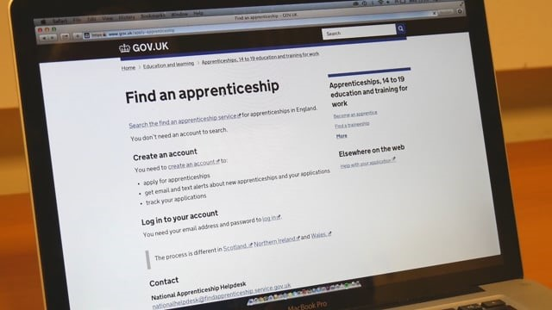
Find an apprenticeship
Get free help and support
Call 0800 0150 400
https://www.findapprenticeship.service.gov.uk/
Notes:
Present notes: Ensure that this film is downloaded, embedded and is working. Click for animation – this is a short film (1m 15s) demonstrating how to use Find an apprenticeship
As discussed before, there are a couple of really useful websites to help your child to start their apprenticeship job search, the main one being Find an apprenticeship.
This is the government, central database advertising live apprenticeship vacancies across all sectors and levels.
This short film will briefly show you the Find an Apprenticeship website and how to sign up and use the site effectively.

Slide 8
More important websites
Abingdon and Witney College
City of Oxford College
HIT Training
Banbury and Bicester College
Oxfordshire Apprenticeships

Slide 9
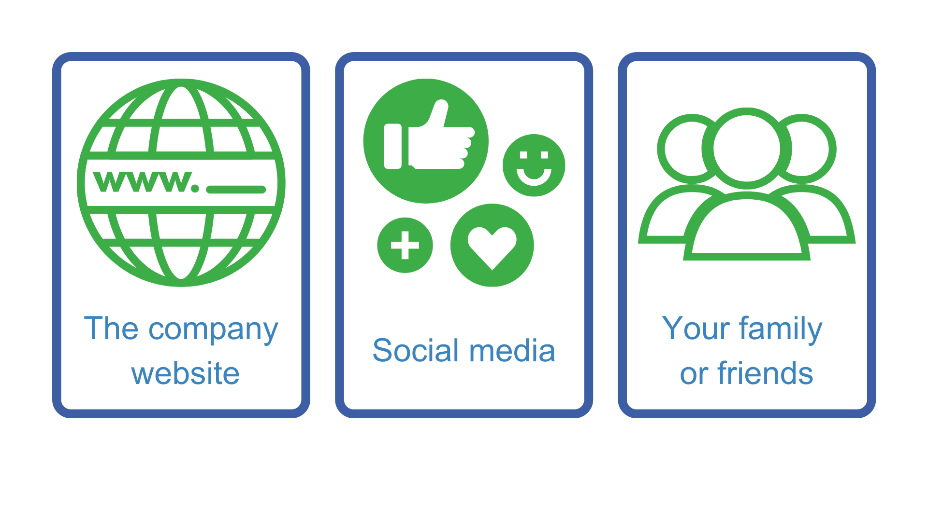
Where else to look
Notes:
Whilst Find an apprenticeship is a great place to start looking for apprenticeships, it is not the only place.
If your child has a particular employer in mind, visit their website and see if they can sign up for recruitment alerts or if they send out a newsletter.
Make sure your child follows their careers pages on social media using Facebook, Twitter and Instagram too as they will probably use this as a way to promote their vacancies.
We have spoken to lots of apprentices and quite often, they will say that they actually heard about their job through a family member or friend. So make sure you tell everyone you can think of that you’re looking for an apprenticeship and you never know what might come through!
There are lots of other job search sites out there, including apprenticeships.gov.uk, where you can flick through online profiles for some of the UK’s top apprentice employers.
Definitely spend some time looking into the different types of employers. There will be a real mix from your local council who might have a jobs page for young people, through to bigger recruitment sites too.

Slide 10




HOW TO APPLY?
Step 1 – Click ‘Apply Now’ on the company website and fill out an application form
Step 2 – You will probably have to fill out online questionnaires or assessments to determine your suitability for the role
Step 3 –You might initially have a pre-recorded video interview, or telephone or online interview
Step 4 – You may have to attend an Assessment Centre
Step 5 – The main interview! This may be a group, panel or one to one interview
© Copyright 2021. All rights reserved - Adviza Partnership

Slide 11


Writing an Effective CV

Slide 12

CV MYTHS: TRUE OR FALSE?
2
3
4
1
CVs don’t have to include referee
details
It is important to include your date of birth & nationality
The purpose of a CV is to get you the job
CVs have to cover 2 pages
5
6
7
8
Writing ‘Curriculum Vitae’
at the top helps the reader identify what it is
If you have a driving license say so
Using colour is better than not using colour
The order information is presented is important
© Copyright 2021. All rights reserved – Adviza Partnership

Slide 13

TYPES
There are 2 types of CV:
Chronological
Functional
CHRONOLOGICAL
Lists your work experience and education
in chronological order
A LITTLE BIT OF
THEORY
FUNCTIONAL
Concentrates more on what you can do and what you can offer to the employer
WHICH SHOULD I CHOOSE?
Nowadays most CVs use a combination of both types
© Copyright 2021. All rights reserved – Adviza Partnership

Slide 14

NAME & CONTACT DETAILS
Details you are happy for the employer to use
Be aware of inappropriate email addresses
HOBBIES & INTERESTS
Where possible list interests related to the post applied for
Try not to be too general
PRIORITISING
CV SECTIONS
WORK EXPERIENCE/HISTORY
Name of role and brief list of duties, ideally in bullet points
Typically most recent first
PERSONAL PROFILE
Short, punchy paragraph about you
EDUCATION
Include grades, training courses and qualifications
SKILLS
Include if relevant to the post, be specific and use brief examples where possible
© Copyright 2021. All rights reserved – Adviza Partnership

Slide 15

THINGS TO AVOID:
Anyone who sees a lot of CVs (and that includes most employers) will often see the same phrases being used over and over again
Tired old clichés with no evidence to back it up
TYPES OF PHRASES TO CONSIDER:
Excellent communication skills
Reliable
Hardworking
Good team player
If you do use these phrases make sure you are specific in what you are referring to and give an example where possible

Slide 16
Thank you!

